Slide 1

Information for Parents of
Ironville and Codnor Park Primary School
Notes:
Welcome and thank you for taking the time to join us.
Lots of evidence to show that the best education is when parents and school work together to support the development of our children.

Slide 2

Some slides will contain this
speaker icon
Click on this to listen to an explanation and more information about the slide.
Notes:
Welcome and thank you for taking the time to join us.
Lots of evidence to show that the best education is when parents and school work together to support the development of our children.

Slide 3
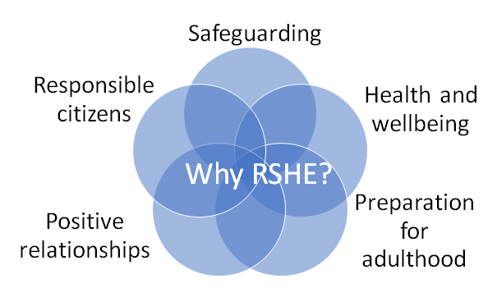
What is RSHE all about?
Teaching children how to grow up to be healthy, happy, safe, and able to manage the challenges and opportunities of modern Britain.
To give children the knowledge to make informed decisions about their wellbeing, health and relationships as well as preparing them for a successful adult life.

Slide 4
What’s new? What has changed?
The world for all young people looks very different from the way it did 20 years ago when this curriculum was last updated so the Department for Education have introduced new guidance for the teaching of RSHE to bring the content into the 21st century, so that it is relevant for your child and the world they live in.
Notes:
Internet safety, cyber bullying, child/online grooming.
Children live online and have access to so much that in the past they wouldn’t have been exposed to so it is important that we can teach them to be aware and keep themselves safe.

Slide 5

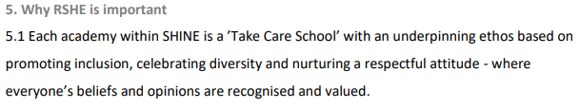
What does our policy say?

Slide 6
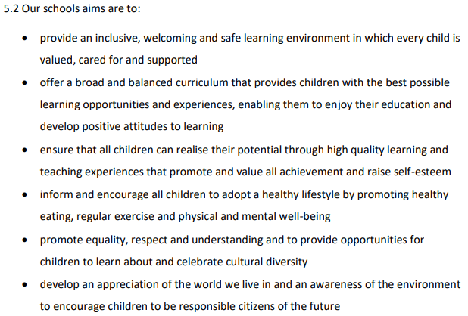
What does our policy say?

Slide 7
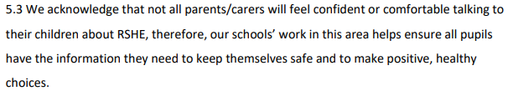
What does our policy say?

Slide 8
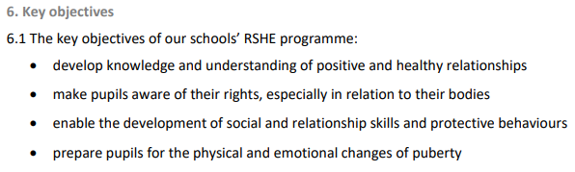
What does our policy say?

Slide 9
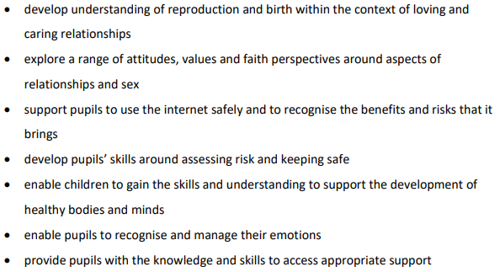
What does our policy say?

Slide 10
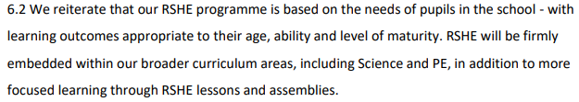
What does our policy say?

Slide 11
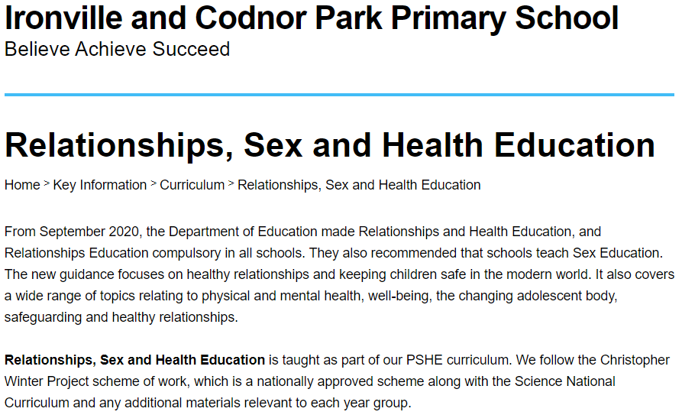
Notes:
To ensure that we followed the guidance set out by the government, we published our draft RSHE policy and shared this with parents in September 2020 along with a questionnaire to gain your views, giving parents the opportunity to have their say about what they thought was appropriate content as well as the appropriate age for this content to be taught.
Following that consultation period and with your agreement, the following is what we set out would be taught to each year group:

Slide 12

Relationships Education
  Respectful relationships - primary
    Respecting others
    Courtesy and manners
    Self-respect
    Anti-bullying
    Stereotypes
    Permission seeking
Notes:
FRAN
You don’t need to go through all of these on the slides following just pick up on a few and encourage people to look in the guidance for more details on the outcomes

Slide 13

Relationships Education
  Families - Primary
    Healthy family life
    Diversity of families
    Marriage and civil partnerships
    Stable, caring relationships
    How to seek help if they are unhappy
  Caring friendships - Primary
    Importance of and characteristics of friendships
    Healthy friendships
    Ups and downs
    Who to trust
Notes:
FRAN
DFE RSHE guidance pages 20 to 22 – Relationships Education
Pages 32 to 35 – Health Education
These are the outcomes that primary pupils are expected to have achieved by the end of primary
There is, of course, flexibility for those with SEND.
Comment on the fact that much of this content schools will be covering in some way already, maybe through assemblies, circle time, etc.

Slide 14

Relationships Education
  Online relationships - primary
    Behaviour online
    Keeping safe
    Be critical of friendships/information
    How data is shared and used
  Being safe - primary
    Appropriate boundaries in friendships
    Privacy and secrets
    Each person’s body belongs to them
    Responding to adults they don’t know
    Getting help and advice
Notes:
DEEPA
The new guidance has put more emphasis on the risks associated with the internet – this is reflected in both the relationships and health education outcomes

Slide 15
Health Education (HE)
  Mental wellbeing - primary
    Recognising and talking about emotions
    How to judge the appropriateness of their feelings
    The benefits of exercise
    Simple self-care techniques
    About isolation and loneliness
    Impact of bullying on wellbeing
    Where and how to seek support
  Internet safety and harms - primary
    Benefits of the internet
    Benefits of managing time spent on the internet
    Why social media and games are age restricted
    The the internet can be a negative place with trolling, bullying and harassment
    Be a discerning consumer of information online
    What and how to report concerns
Notes:
DEEPA

Slide 16
Health Education
  Physical health and fitness - primary
    Benefits of an active lifestyle
    Importance of building exercise into daily routine
    The risks of an inactive lifestyle
    How and when to seek support if they are worried about their health
  Healthy eating - primary
    What constitutes a healthy diet
    Principles of planning a range of health meals
    Characteristics of a poor diet and risks associated with this
Notes:
DEEPA
Your PE curriculum is perfect for cross curricular opportunities here

Slide 17

Health Education
  Drugs, alcohol and tobacco - primary
    Facts about legal and illegal substances and associated risks
  Health and prevention - primary
    How to recognise early signs of physical illness
    About safe and unsafe exposure to the sun
    The importance of sufficient good quality sleep
    About dental health and good oral hygiene
    About personal hygiene and germs
    Facts relating to allergies, immunization and
    vaccination
Notes:
DEEPA

Slide 18

Health Education
  Basic first aid - primary
    How to make a call to emergency services
    Concepts of basic first aid
  Changing Adolescent Body - primary
    Key facts about puberty and the changing adolescent body
    About menstrual wellbeing including key facts about the menstrual cycle
Notes:
DEEPA
Basic first aid at primary is just that..basic! How to make an emergency call, recognizing when they might need help.
Changing adolescent body is puberty – this is now statutory whether covered in Science or in the Health Education curriculum – this is different to before

Slide 19
Sex Education
“The Department continues to recommend...that all primary schools should have a sex education programme tailored to the age and the physical and emotional maturity of the pupils. It should ensure that both boys and girls are prepared for the changes that adolescence brings and – drawing on knowledge of the human life cycle set out in the national curriculum for science - how a baby is conceived and born.”
DFE RSHE Guidance 2019
Notes:
FRAN
Parents can withdraw from the Sex Education elements – this is usually the lessons given in year 6 (or sometimes year 5) around conception, pregnancy, birth, maybe contraception, consent, etc.
Yr 2 - Pupils should be taught to:
notice that animals, including humans, have offspring which grow into adults
describe the importance for humans of…..hygiene.
They should also be introduced to the processes of reproduction and growth in animals. The focus at this stage should be on questions that help pupils to recognise growth; they should not be expected to understand how reproduction occurs.
The following examples might be used: egg, chick, chicken; egg, caterpillar, pupa, butterfly; spawn, tadpole, frog; lamb, sheep. Growing into adults can include reference to baby, toddler, child, teenager, adult.
Yr 5 Pupils should be taught to:
describe the changes as humans develop to old age.
describe the differences in the life cycles of a mammal, an amphibian, an insect and a bird
describe the life process of reproduction in some plants and animals
Pupils could work scientifically by researching the gestation periods of other animals and comparing them with humans; by finding out and recording the length and mass of a baby as it grows.
Pupils should find out about different types of reproduction, including sexual and asexual reproduction in plants, and sexual reproduction in animals.
Pupils might work scientifically by: observing and comparing the life cycles of plants and animals in their local environment with other plants and animals around the world (in the rainforest, in the oceans, in desert areas and in prehistoric times), asking pertinent questions and suggesting reasons for similarities and differences. They might try to grow new plants from different parts of the parent plant, for example, seeds, stem and root cuttings, tubers, bulbs. They might observe changes in an animal over a period of time (for example, by hatching and rearing chicks), comparing how different animals reproduce and grow.
Year 6 Pupils should be taught to:
recognise that living things produce offspring of the same kind, but normally offspring vary and are not identical to their parents
https://www.gov.uk/government/publications/national-curriculum-in-england-science-programmes-of-study/national-curriculum-in-england-science-programmes-of-study

Slide 20

Engaging with parents and carers
“We are clear that parents and carers are the prime educators for children on many of these matters. Schools complement and reinforce this role and have told us that they see building on what pupils learn at home as an important part of delivering a good education.”
DFE RSHE Guidance 2019
“Engagement works best when everyone involved enters into it with an open mind.”
Notes:
FRAN
Highlight this a useful document

Slide 21
What will children be taught via the Christopher Winter Project scheme of work?
Reception:
Routines of the day and how to look after themselves
Why hygiene is important and basic hygiene routines
Recognise that all families are different and understand how family members can help each other
Reception Vocabulary:
Dress, undress
Clean, smelly
Flannel, sponge, towel, hands, toothpaste, toothbrush, hairbrush, comb
Family, mum, dad, brother, sister, grandma, grandad, stepmum, stepdad
Year 1:
Basic washing and cleanliness
That people change and grow
The difference between boy and girl babies
Year 1 Vocabulary:
Clean
Similar, different
Family, boy, girl, male, female
Body parts, penis, vagina

Slide 22
What will children be taught via the Christopher Winter Project scheme of work?
Year 2:
Describe the differences between boy and girl babies and talk about similarities and differences between boys and girls in relation to gender stereotypes
Describe differences between male and female animals
Identify parts of the body using pictures.
Year 2 Vocabulary:
Similar, different
Sex, gender roles, stereotypes
Boy, girl, male, female
Body parts, penis, vagina
Year 3:
Name the body parts and discuss similarities and differences
Talk about appropriate and inappropriate touch and to learn about personal space
Understand who to go to for support and understand that families are different and have different members
Year 3 Vocabulary:
Stereotypes, gender roles, similar, different
Male, female, body parts, penis, vagina
Family, fostering, adoption, relationships

Slide 23
What will children be taught via the Christopher Winter Project scheme of work?
Year 4:
Children will:
Understand the human life cycle and describe body changes that happen when a child grows up
Understand basic facts about puberty, reproduction and pregnancy
Learn about the physical and emotional changes associated with puberty
Year 4 Vocabulary:
Puberty, lifecycle, reproduction, pregnancy
Physical, breasts, sperm, egg, pubic hair
Emotions, feeling
Year 5:
Children will be able to:
Discuss the main physical and emotional changes that occur during puberty
Describe how to manage physical and emotional change
Explain how to keep clean and know how to get help and
  support during puberty
Year 5 Vocabulary:
Puberty, physical changes, emotional changes
Moods, menstruation, periods, tampons, sanitary towels
Wet dreams, semen, erection
Sweat, breasts, spots, pubic hair, facial hair, underarm hair
Sexual feelings

Slide 24
What will children be taught via the Christopher Winter Project scheme of work?
Year 6:
Children will be able to:
Describe how and why the body changes during puberty in preparation for reproduction
Explain how babies are made and the types of adult relationships
Describe some basic facts about pregnancy and conception and the decisions that are made before having a baby
They will understand how to stay safe online and what Female Genital Mutilation is
Year 6 Vocabulary:
Womb, egg
Sperm, conception, fertilisation, contraception, pregnancy, sexual intercourse
Twins, fostering, adoption
Relationships, friendships, love, consent, intimacy
Communication, personal/private information, internet safety

Slide 25
Parents right to withdraw:
Parents have the right to request that their child be withdrawn from some or all of sex education delivered as part of statutory RSHE.
Children can not legally be withdrawn from the science units of the curriculum, where children learn about the changes of the body during puberty and animal and human reproduction.
Children can not be withdrawn from the health and healthy relationships aspects of RSHE.
This request will need to be granted by either Mrs Grundy or Mrs Smedley
Consider consequences of withdrawal:
Will your child feel excluded and anxious by not knowing what the others have been doing?
Consider the likelihood and consequences of your child hearing
their peers’ version of what was said rather than what was
directly said by the teacher

Slide 26
Our class agreement when discussing ‘tricky’ subjects.
Listen well
Ask questions but not personal ones
Take part
Respect each other
Say when you don’t understand
Use agreed words
Talk about content with classmates/trusted adults
Do not discuss with younger children
If we feel someone is not safe we will help them
As always, our RESPECT behaviour policy ensures children are behaving as we expect them to, in the best interests of themselves and each other.
Notes:
FRAN
Pupils should not be asking personal questions of the teacher or other students
Talk about yourself and not others – you don’t want pupils sharing information about others, eg. Sophie has started her periods already
Use the agreed words – pupils should be encouraged to use scientific terms for genitals
Talk about content – encourage pupils not to talk with younger children about more detailed content

Slide 27
Our strategies for answering children’s questions:
  We have a question box for children to confidently ask any questions they want within the parameters of the class agreement
  This allows the teacher time to consider the most age-appropriate, factually accurate answer
  The questions may be read out anonymously, then answered for the whole class to hear if appropriate
  Questions may be answered privately, just with the child who asked
  We may discuss this with parents or carers if we feel this is necessary

Slide 28
Useful links for parents:
  New RSE guidance from 2020 https://assets.publishing.service.gov.uk/government/uploads/system/uploads/attachment_data/file/781150/Draft_guidance_Relationships_Education__Relationships_and_Sex_Education__RSE__and_Health_Education2.pdf
  Parent Frequently Asked Questions: https://www.gov.uk/government/news/relationships-education-relationships-and-sex-education-rse-and-health-education-faqs
  RSE Primary School Parent Guide: https://assets.publishing.service.gov.uk/government/uploads/system/uploads/attachment_data/file/907638/RSE_primary_schools_guide_for_parents.pdf
  Please do contact me for any further information or if you would like to view the teaching resources we use in school:
  rmee2@ironvillecodnorpark.derbyshire.sch.uk
Notes:
FRAN

