Slide 1

Ironville and Codnor Park Primary School
Newsletter
13th July 2026
Believe Achieve Succeed
Wonderful World Week
If you have booked in to attend your child’s lunch and stay this week please go to the hall gate for 12:30 p.m. If you have booked in for the session only, please go to the main reception for 1:00 p.m. Both sessions finish at 2:15 p.m. Don’t forget your passport and suitcase!
Unfortunately, if you did not complete the slip you won’t be able to attend these events.
Summer Birthdays
As a little treat for the children and staff who have/will have a birthday between 13th April to 31st August they are allowed to come to school this Thursday in non- uniform so everyone in school can wish them a happy birthday.
Annual Reports
Your child’s annual report will be sent home this Friday. If you would like an additional copy of the report for a parent with whom the child does not reside, please let Mrs Moore know by Wednesday 15th at the very latest. If you would like to discuss anything in your child’s report there will be a parents’ evening on Wednesday 22nd from 3:15 p.m. - 4:00 p.m. for Wrens, Robins, Shining Start, Kingfishers and Kestrels. There is no need to make an appointment, please just call in.
If your child is in Eagles and you would like to discuss anything in the report please contact Mrs Moore and let her know by Tuesday 22nd July and Mrs Morley will contact you by telephone on Wednesday 22^{nd.}
Attendance – Forest School Day
On Monday 20th children who have got 96+% attendance for the whole of the school year will have a Forest School day as a reward. If your child has achieved this Mrs Moore will send you a message this Friday with further details.
Winning House Team
A huge congratulations goes to Kedleston who have won the House Team award for this year! The team have worked really hard to win by gaining points on sports day, completing homework, spelling tests and achieving house points for good work. The winning team members are lucky enough to be going on a visit to their ‘House’ on Wednesday 22nd with Mr Garrard and other staff members. If your child is in the winning team they will be bringing home a letter on Thursday which must be returned by Monday at the very latest.
Diary Dates
July
13th Wonderful World Week
15th Kestrels trip to London
16th Summer birthdays – non-school uniform
17th Homework and clubs finish
20th Forest School Day with parents for attendance
21st First Aid Day
22nd House Trip
23rd Last Day of School
New dates in blue

Slide 2
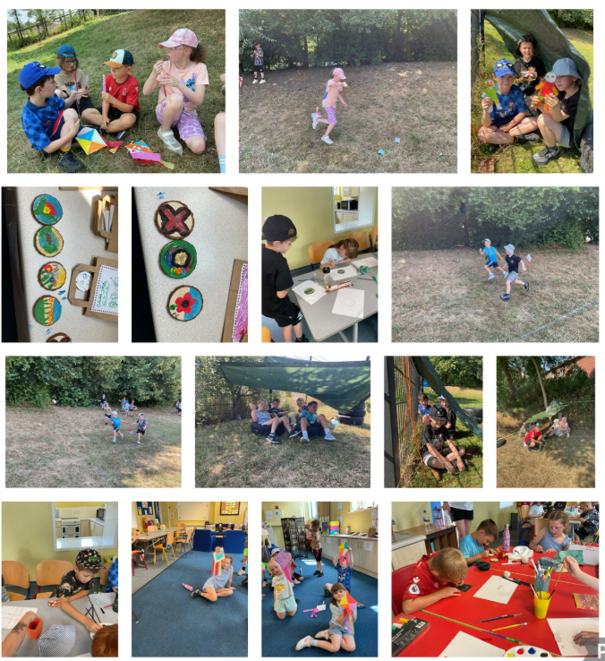


Believe Achieve Succeed
Wrens– Jacob Fenwick
Robins – Teddy Pettifer
Kingfishers – EL
Kestrels – William Purdy
Eagles – ES
********************* School Rewards *********************
Headteacher’s Award
Kason Cunning
Wonderful Writer
Junior Douglas
A huge thank you goes to Mrs Bowler, Mrs Coulston, Mr Garrard and Miss Stevenson who kindly gave up their Friday night to run this residential for the children. Here are just a few of the photographs from the daytime activities – check out all of them on our website.
Year Three Residential
Although the children were not able to sleep overnight due to the hot weather, all of the year threes had a fabulous day.
A huge thank you goes to Miss Stevenson who planned exciting activities.
Here are just a few of the photographs from the daytime activities.
Safeguarding
If you have a concern regarding child protection or safeguarding please contact:
The Designated Safeguarding Lead – Mrs Grundy and Mrs Bowler (Fridays)
The Deputy Safeguarding Leads – Miss Sharpe, Mrs Coulston, Mrs Bowler, Mrs Nicholson and Mrs Moore
Starting Point (For all Safeguarding Concerns) 01629 533190
NSPCC Helpline: 0808 8005000
Read to the Beat arrives in libraries across England and Wales, TODAY!
Start your summer of storytelling with rhythm, music and creativity! Find out how your local library is kickstarting this year’s Summer Reading Challenge.
The Challenge is already in full swing in Scotland, and children can also join the ensemble by taking part online through https://summerreadingchallenge.org.uk/
Address: Victoria Street, Ironville, Derbyshire, NG16 5NB
Telephone: 01773 602936
Email: info@ironvillecodnorpark.derbyshire.sch.uk

Slide 3








Weekly Attendance 6th July 2026
1st
Chatsworth
98.5%
2nd
Hardwick
95.24%
2nd
Kedleston
93.25%
3rd
4th
Calke Abbey
93.04%
Our target for whole school attendance is 96+ or above. This week it was 95.00%. The number of lates after 8:50 a.m. was 4
Show Up! Shout Out! Win for your house!

